Slide 1
OPERATION AND METRIC ANALYTICS

Slide 2
Project Description :-
Operation Analytics is the process of using data analysis and business intelligence to improve efficiency and
streamline everyday operations in real time. A subset of business analytics, operational analytics is supported by
data mining, artificial intelligence, and machine learning. It requires a robust team of business and data analysts. In
this assignment I worked closely with the operational team, support team, and the marketing team, which helped
me derive insights out of the data provided by the team.
In this assignment I have analysed job reviews, no of events happening in the company, how many languages do
people speak in the company and any duplication of records. Investigating metric spike is also an important part of
operation analytics as being a Data Analyst ,we must be able to understand or make other teams understand
questions regarding engagement, growth, weekly retention, email etc.
Approach:-
I Firstly evaluated the objectives and considered the actual data that the team needed and after that I imported the
data into www.DB Fiddle.com and www.Mode.com and ran numerous queries to acknowledge the data and track
down the insights that the team desired for maximum marketing,support and operational growth.

Slide 3
Tech Stack Used:
Db Fiddle (SQL Database Playground) – My SQL v 8.0 and
Mode.com (A cloud based collaborative analytics platform).
Insights:
I ran various sql commands to acquire insights and understanding of how to handle real time sql
queries through this assignment.I analysed the dataset furnished by the team and derived several
insights about weekly user engagement, user growth, weekly retention, email engagement, number of
jobs, and duplicate data .

Slide 4
JOB DATA
Case Study 1 (JOB DATA):
Number of jobs reviewed : Amount of jobs reviewed over time.
a) TASK: Calculate the number of jobs reviewed
per hour per day for November 2020?
QUERY:
SELECT EXTRACT(week from occurred_at) as weeknum,
COUNT(DISTINCT user_id) FROM tutorial.yameer_events a
GROUP BY weeknum

Slide 5
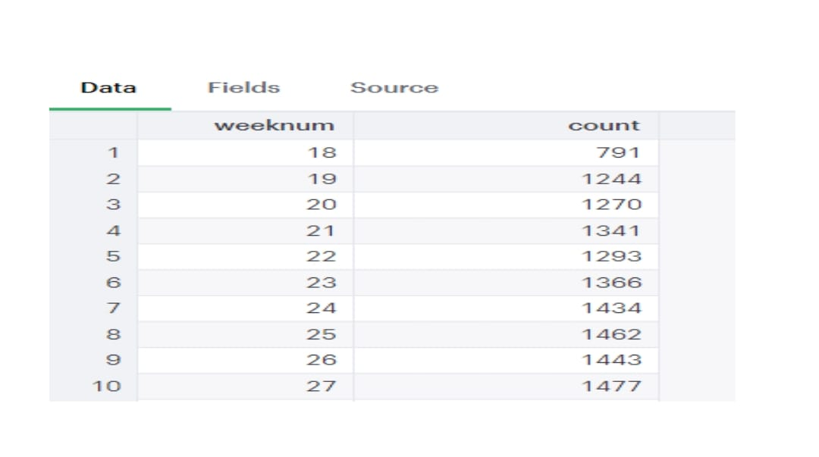

Slide 6
THROUGHOUT
b) TASK: Let’s say the above metric is called throughput. Calculate seven day rolling average ofthroughput? For throughput, do you prefer daily metric or seven day rolling and why ?
QUERY:
SELECT ds,jobs_reviewed
AVG(jobs_reviewed)OVER(ORDER_BY ds ROWS BETWEEN 6 PRECEDING AND CURRENT ROW)
AS throughput_7 FROM(SELECT ds,COUNT(DISTINCT job_id) AS jobs_reviewed
FROM job_data WHERE ds BETWEEN ‘2020-11-01’ AND ‘2020-11-30’
GROUP BY ds ORDER BY ds) a

Slide 7
ds | Jobs_reviewed
2020-11-25 | 1
2020-11-26 | 1
2020-11-27 | 1
2020-11-28 | 2
2020-11-29 | 1
2020-11-30 | 2

Slide 8
PERCENTAGE SHARE OF EACH LANGUAGE
c)TASK: Calculate the percentage share of each language in the last 30 days ?
QUERY:
SELECT language,num_jobs,100.0*num_jobs/total_jobs AS pct_jobs
FROM(SELECT language,COUNT(DISTINCT job_id) AS num_jobs FROM job_data
GROUP BY language) a
CROSS JOIN (SELECT COUNT(DISTINCT job_id) AS total_jobs FROM job_data) b

Slide 9
OUTPUT
language | Num_jobs | Pct_jobs
Arabic | 1 | 12.50000
English | 1 | 12.50000
French | 1 | 12.50000
Hindi | 1 | 12.50000
Italian | 1 | 12.50000
Persian | 3 | 37.50000

Slide 10
DUPLICATE ROWS
d)TASK: Let’s say you see some duplicate rows in the data.How will you display duplicates from the table?
QUERY:
SELECT * FROM (SELECT * ROW_NUMBER()OVER(PARTITION BY job_id) AS row_num
FROM job_data
) a WHERE row_num>1

Slide 11
OUTPUT:
Job_id | Actors_id | event | language | Time_spent | org | ds | Row_num
28 | 1008 | transfer | Italian | 45 | C | 2020-11-25 | 2

Slide 12
CASE STUDY 2 (INVESTIGATING METRIC SPIKE)
User Engagement: To measure the activeness of a user. Measuring if the user finds quality in a product or service.
a)TASK: Calculate the weekly user engagement ?
QUERY:
SELECT EXTRACT(week FROM occurred_at) AS weeknum,
COUNT(DISTINCT user_id)
tutorial.yammer_events a
GROUP BY weeknum

Slide 13
OUTPUT:
weeknum | count
18 | 791
19 | 1244
20 | 1270
21 | 1341
22 | 1293
23 | 1266
24 | 1434
25 | 1462
26 | 1443

Slide 14
USER GROWTH
b) TASK: Calculate the user growth for product
QUERY:
SELECT year,weeknum,num_active_userSUM(num_active_user) OVER
(ORDER_BY year,weeknum ROWS BETWEEN UNBOUNDE PRECEDING AND CURRENT ROW)
AS cum_active_users FROM (
SELECT EXTRACT (year from a.activated_at) AS year,
EXTRACT (year from a.activated_at) AS weeknum,
COUNT(DISTINCT user_id) AS num_active_user
FROM tutorial.yammer_users a WHERE state=‘active’ GROUP BY year,weeknum
ORDER BY year,weeknum) a ,

Slide 15
OUTPUT:
year | weeknum | num_active_user | cum_active_user
2013 | 1 | 67 | 67
2013 | 2 | 29 | 966
2013 | 3 | 47 | 143
2013 | 4 | 36 | 179
2013 | 5 | 30 | 209
2013 | 6 | 48 | 257
2013 | 7 | 41 | 298
2013 | 8 | 39 | 337
2013 | 9 | 33 | 370
2013 | 10 | 43 | 413

Slide 16
WEEKLY RETENTION
c)TASK: Calculate the weekly retention of users-sign up (cohort) ?
QUERY:
SELECT COUNT(user_id)SUM(CASE WHEN retention_week = 1 THEN 1 ELSE 0 END) as week_!
FROM(SELECT a.user_id,a.signup_week,b.engagement_week, b.engagement_week – AS retention_week
FROM((SELECT DISTINCT user_id ,EXTRACT(week FROM occurred_at)AS signup_week
FROM tutorial.yammer_events WHERE event_type =‘signup flow’ AND event_name=‘complete_signup’ AND EXTRACT(week from occurred_at)=18) a
LEFT JOIN(SELECT DISTINCT user_id,EXTRACT(week FROM occurred_at)AS engagement_week
FROM tutorial.yammer_events WHERE event_type = ‘engagement’) b
ON a.user_id = b.user_id) ORDER BY a.user_id) a

Slide 17
OUTPUT:
count | Week_!
317 | 64

Slide 18
WEEKLY ENGAGEMENT
d)TASK: Calculate the weekly engagement per device ?
QUERY:
SELECT
EXTRACT(year FROM occurred_at) AS year,
EXTRACT(week FROM occurred_at) AS week,
device,
COUNT(distinct_user_id) FROM tutorial.yammer_events WHERE event_type=‘engagement’ GROUP BY 1,2,3 ORDER BY 1,2,3

Slide 19
OUTPUT:
year | week | device | count
2014 | 18 | Acer aspire desktop | 10
2014 | 18 | Acer aspire desktop | 21
2014 | 18 | Amazon fire phone | 4
2014 | 18 | Asus chromebook | 23
2014 | 18 | Dell inspiron desktop | 21
2014 | 18 | Dell inspiron desktop | 49
2014 | 18 | Hp pavilion desktop | 15
2014 | 18 | Htc one | 16
2014 | 18 | Ipad air | 30
2014 | 18 | Ipad mini | 21

Slide 20
EMAIL ENGAGEMENT
e)TASK: Calculate the email engagement metrics ?
QUERY:
SELECT
100*SUM(CASE WHEN email_cat=‘email_open’ THEN 1 ELSE 0 END)/SUM(CASE WHEN email_cat = ‘email_sent’ THEN 1 ELSE 0 END)AS email_open_rate,
100*SUM(CASE WHEN email_cat=‘email_clicked’ THEN 1 ELSE 0 END)/SUM(CASE WHEN email_cat = ‘email_sent’ THEN 1 ELSE 0 END)AS email_clicked_rate,
FROM(SELECT*,CASE WHEN action IN(‘sent_weekly_digest’,’sent_reengagement_email)
THEN ‘email_sent’ WHEN action IN(‘email_open’) THEN ‘email_open’
WHEN action IN (‘email_clickthrough’) THEN ‘email_clicked’
END AS email_cat FROM tutorial.yammer_emails ) a

Slide 21
OUTPUT
Email_open_rate | Email_clicked_rate
33.5834 | 14.7899

